Slide 1
Women at Work
Website Redesign
Srikant Madhava, Project Manager
Sanath Bhandary, Operational Concept Engineer
Rohit Kudva, Feasibility Analyst
Varma Maryala, Life Cycle Planner
Praneet Surana, Requirements Engineer
Dinesh Yeduguru, Software Architect
Nishant Jani, Prototyper
Brian Bousman, IIV&V

Slide 2
Strengths & Concerns
Brian bousman

Slide 3
Team Strong and Weak Points
Strengths
Operational View
Great positive team interaction
Technical View
Good individual experience with the technologies needed for this project
Weaknesses
Operational View
Busy work/school schedules make meetings difficult to arrange
Team has never worked together before
Technical View
No familiarity with key part of customer software (Neon CRM)

Slide 4
Technical Concerns
As the current Neon CRM API is in its beta version, the future versions of the API may not be backward compatible
Switch to manual entry in Neon until source code is updated to use the new API
Document interface for future maintainers!
Development work on the production system might cause data corruption/leak or site downtime
Do as much development as possible on a copy of the website and database

Slide 5
Operational Risks
WAW server personnel may not have enough experience to maintain the newly installed MySQL
Provide necessary training to the server personnel
Document MySQL installation and maintenance procedures
Crash of on-site check-in system leaves WaW personnel unable to register clients
Provide simple electronic data registration such as spreadsheet or even paper forms to gather client data until system is operational

Slide 6
Win-Win Conditions
Win Conditions Shaping Status : 13 Agreed and 5 open.
Highlighted Agreed Win Conditions
Win Condition (WC_3377): Report generation
As a WaW IT personnel I can generate reports so that I can track how many clients showed up for the counseling session.
Win Condition (WC_3197): Deployment
The WaW website shall use the existing GoDaddy account.
Win Condition (WC_3198): Tools and Languages
The WaW website shall use Wordpress.

Slide 7
Win-Win (continued)
Highlighted Agreed Win Conditions
Win Condition (WC_3193): Private Management Portal
As a board member at WaW I can access the private portal so that I can share, view board documents. Board members will upload documents to google drive.
Win Condition (WC_3373): Report generation
As a WaW IT personnel I can generate reports so that I can capture the first time clients entering the center
Win Condition (WC_3196): Blogging
As a member of WaW I can publish blogs on the website so that we can keep our users up-to date about latest events and increase interactivity.

Slide 8
Win-Win (continued)
Highlighted Agreed Win Conditions
Win Condition (WC_3189): Registration form
As a client I can register online so that I can save time entering the data manually. (Demographics, personal information)
Win Condition (WC_3192): Feedback
As a client I can provide an online feedback as per my convenience and in private.
Win Condition (WC_3195): Social Media Integration (Potentially Agreed)
As a member of WaW I can integrate social media on the website so that we can keep our users up-to date about latest events. Whenever a major update is published on the website, there should be a button to confirm the IT personnel if he/she wants to post it onto social media

Slide 9
Win-Win (continued)
Highlighted Agreed Win Conditions
Win Condition (WC_3190): Online Checkin
As a client I can check-in online, (must be validated by neon crm - phone nos and event registered for) for multiple services so that I save time. Online pertains to the intranet at WaW center.
Win Condition (WC_3379): Report Generation
As a WaW IT personnel I can generate reports so that I can analyse how many clients got job and how long they have been at their job. Just read a phone number (unique id) for a client from the CRM and store it off the neon crm and maintain the most recent feedback only.
Win Condition (WC_3374): Report Generation
As a WaW IT personnel I can generate reports so that I can the number of times a client uses the center

Slide 10
Operational Concept Description
Sanath Bhandary

Slide 11
Shared Vision Diagram
Assumptions Users are willing to use the online registration form Users are willing to provide feedback
Stakeholders | Initiatives | Value Propositions | Beneficiaries
Developers Client | Develop/System Redesign Training of Staff/Clients/Users | Improved Data Management Improved Usability for clients Easier/Improved Report generation | Clients of WAW Board Members of WAW System Administrator Maintainer
Costs Development Cost Training Cost Maintenance Cost |  | Benefits Increase the number of User Registration Increase User Traffic on Website Reduce the amount of person to person time involved in registration Faster report Generation

Slide 12
Benefits Chain Diagram

Slide 13
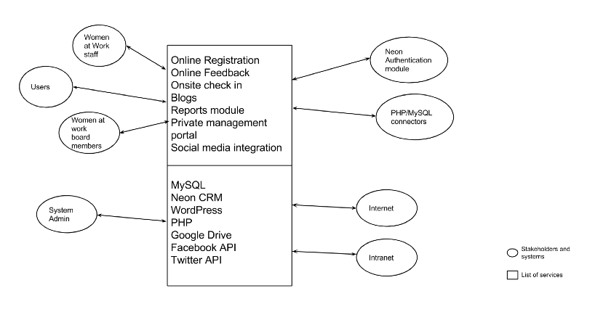
System Boundary Diagram

Slide 14
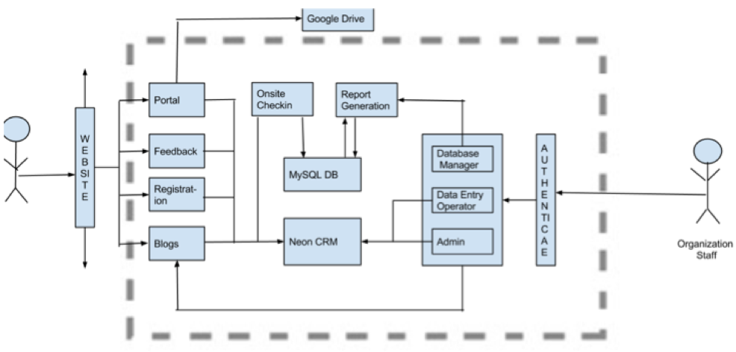
Proposed New System

Slide 15
Organizational Goals
OG-1: Convenient Data Management through data centralization
OG-2: Increase Operational Efficiency through automation
OG-3: Increase number of users via website redesign
OG-4: Raise funds through proposal of statistical data (generated by report module)

Slide 16
Capability Goals
Capability Goals | Priority Level
OC-1 Provide Online Registration | Must Have
OC-2 Provide Onsite Checkin | Must Have
OC-3 Provide Online Feedback | Must Have
OC-4 Private Management Portal | Must Have
OC-5 Automated Report Generation | Must Have
OC-6 Social Media Integration | May Have
OC-7 Provide Blogs | May Have

Slide 17
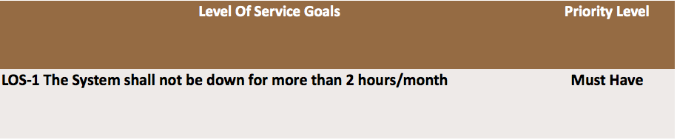
Level of Service Goals

Slide 18
Constraints
The Onsite Check-in System should run on Windows XP
The NDI/NCS to be used during the development should not incur additional cost
Neon CRM should be used as the centralized repository for storing details of users

Slide 19
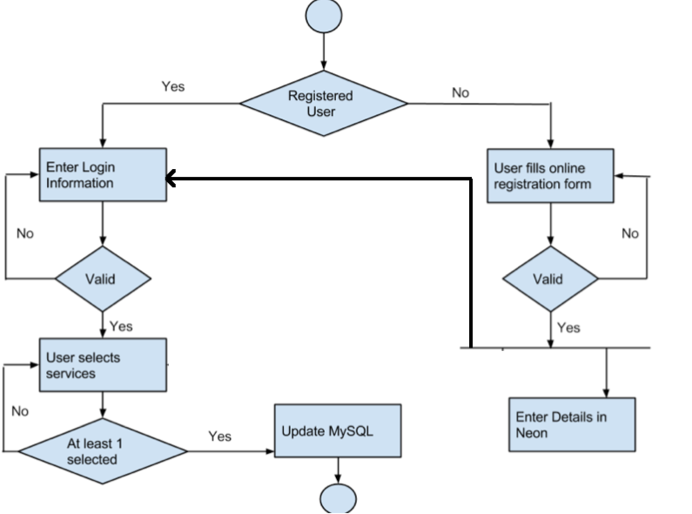
Business Workflow: check-in system

Slide 20
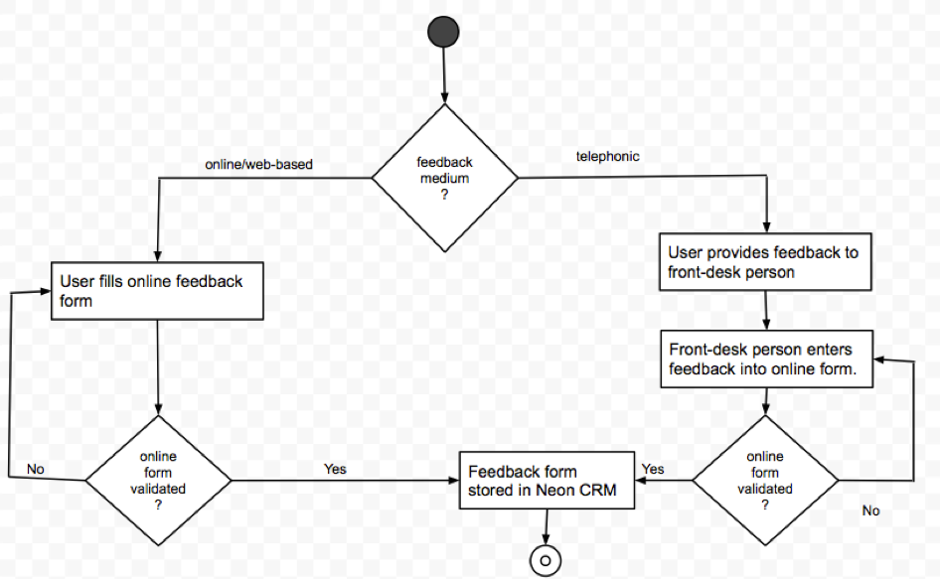
Business Workflow: feedback system

Slide 21
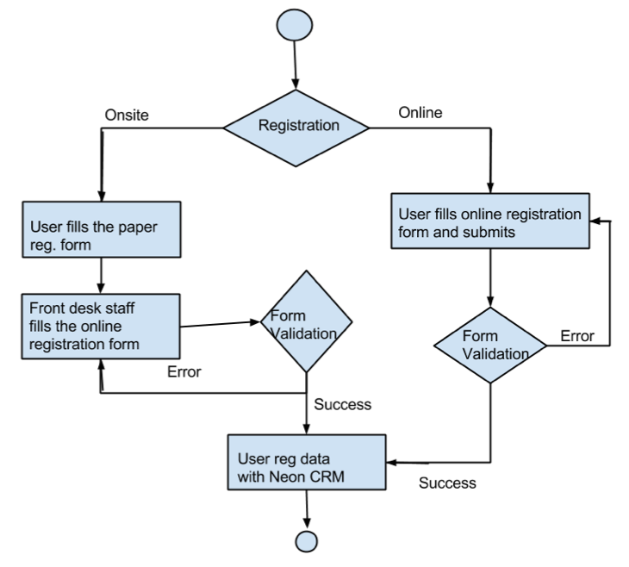
Business Workflow: registration system

Slide 22
Organizational Transformations
The staff working at WaW needs to be trained on the usage of Wordpress engine, report module and the usage of online file sharing tool
Staff should be taught the usage of PhpMyAdmin for accessing database

Slide 23
Operational Transformations
Elimination of email as the medium for sharing of the documents by the board members
Elimination of manual report generation by the Sysadmins
The elimination of time consuming manual entry into Neon CRM by the staff. Use of online form instead of this
Elimination of staff to make telephonic calls to each client individually. Replaced by the online feedback form
Funders have a detailed statistics about the turnout of the users and whether their money is worth spending

Slide 24
Requirements
Praneet Surana

Slide 25
Users
Win Condition (WC_3189): Registration form
As a user I can register online so that I can save time entering the data manually. (Demographics, personal information)
Win Condition (WC_3192): Feedback
As a user I can provide an online feedback as per my convenience and in private.
Win Condition (WC_3190): Online Check-in
As a user I can check-in online, (must be validated by neon crm - phone nos and event registered for) for multiple services so that I save time. Online pertains to the intranet at WaW center.

Slide 26
IT Personnel
Win Condition (WC_3379): Report Generation
As a WaW IT personnel I can generate reports so that I can analyse how many clients got job and how long they have been at their job. Just read a phone number (unique id) for a client from the CRM and store it off the neon crm and maintain the most recent feedback only.
Win Condition (WC_3374): Report Generation
As a WaW IT personnel I can generate reports so that I can the number of times a client uses the center
Win Condition (WC_3373): Report generation
As a WaW IT personnel I can generate reports so that I can capture the first time clients entering the center

Slide 27
IT Personnel
Win Condition (WC_3377): Report generation
As a WaW IT personnel I can generate reports so that I can track how many clients showed up for the counseling session.
Win Condition (WC_3195): Social Media Integration (Potentially Agreed)
As a member of WaW I can integrate social media on the website so that we can keep our users up-to date about latest events. Whenever a major update is published on the website, there should be a button to confirm the IT personnel if he/she wants to post it onto social media

Slide 28
Board Members
Win Condition (WC_3193): Private Management Portal
As a Board member at WaW I can access the private portal so that I can share, view board documents. Board members will upload documents to google drive.
Win Condition (WC_3196): Blogging
As a member of WaW I can publish blogs on the website so that we can keep our users up-to date about latest events and increase interactivity.

Slide 29
System
Win Condition (WC_3197): Deployment
The WaW website shall use the existing GoDaddy account.
Win Condition (WC_3198): Tools and Languages
The WaW website shall use Wordpress.
Win Condition (WC_3481): Deployment
The Onsite check-in shall use WAMP Server.

Slide 30
Prototyping
Nishant Jani

Slide 31
Agenda
Prototyping via UI Designing
Demonstrating Neon CRM REST API

Slide 32

Prototyping via UI Designing
What Win Condition (WC_3189): As a client I can register online so that I can save time entering the data manually. (Demographics, personal information) .
Win Condition(WC_3192): As a client I can provide an online feedback as per my convenience and in private.
Why There are no mocks up or any requirements specified for the UI.
How
Buying information

Slide 33
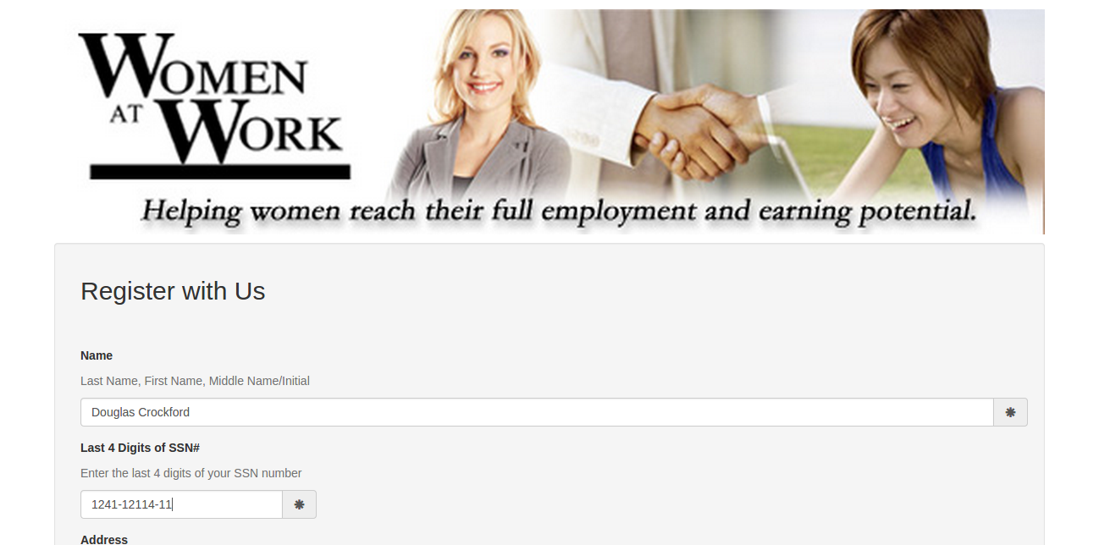
Online Registration Form

Slide 34
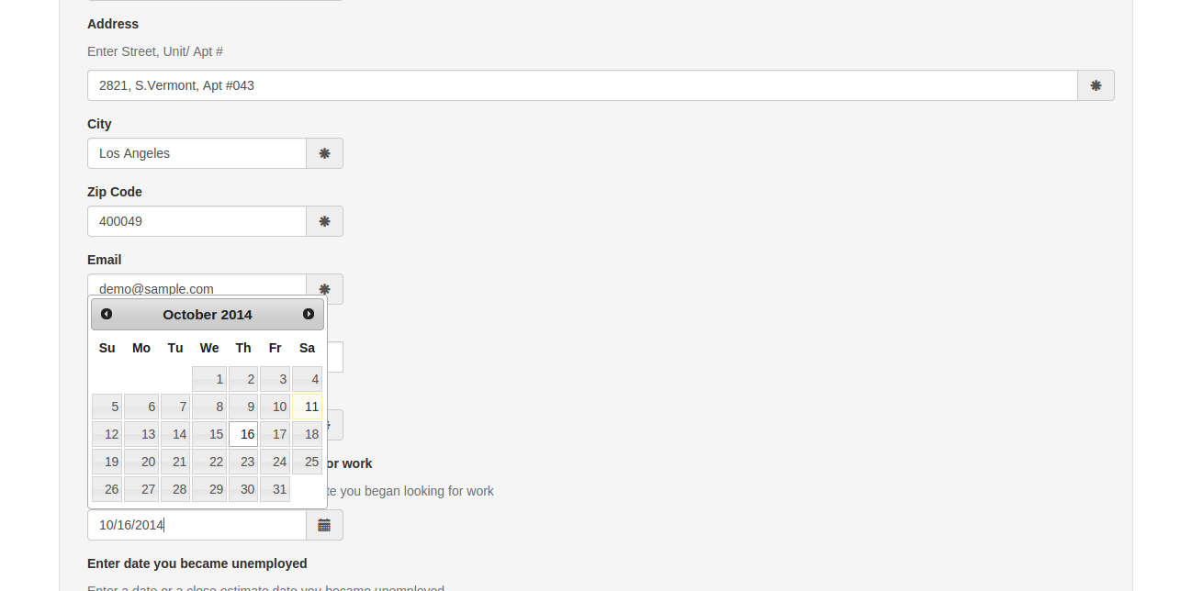
Online Registration Form - II

Slide 35
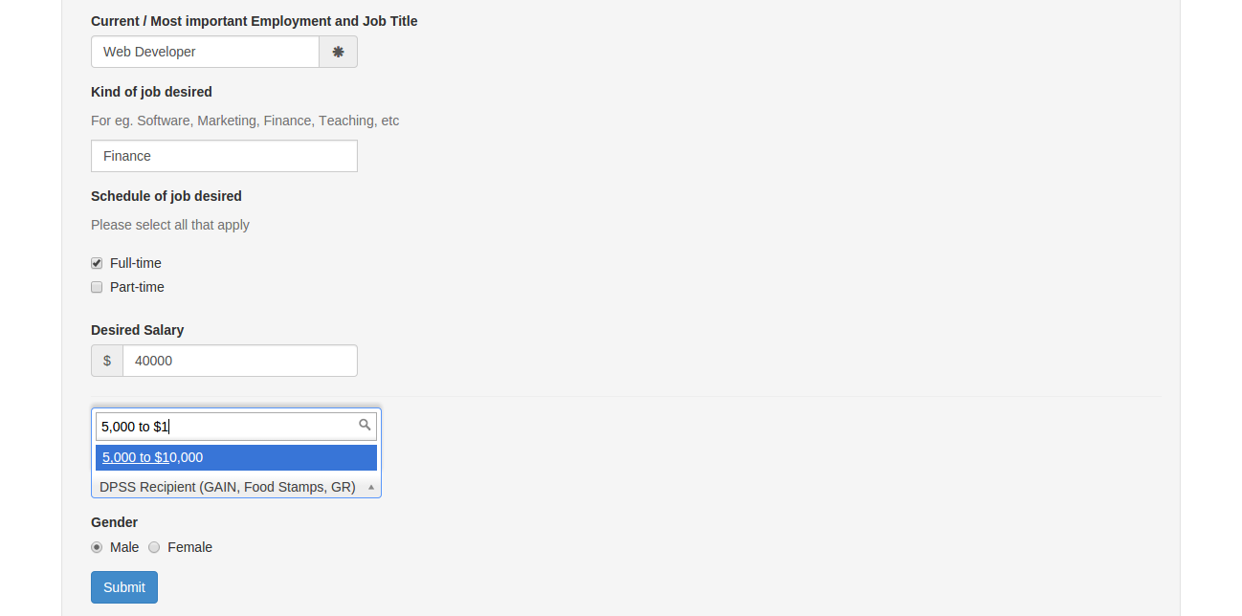
Online Registration Form - III

Slide 36
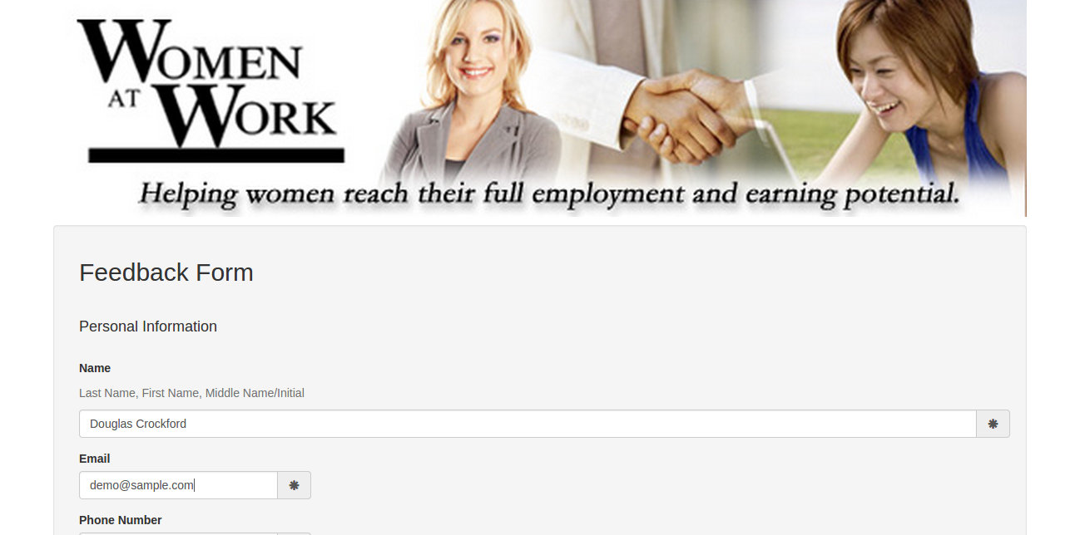
Online Feedback Form

Slide 37
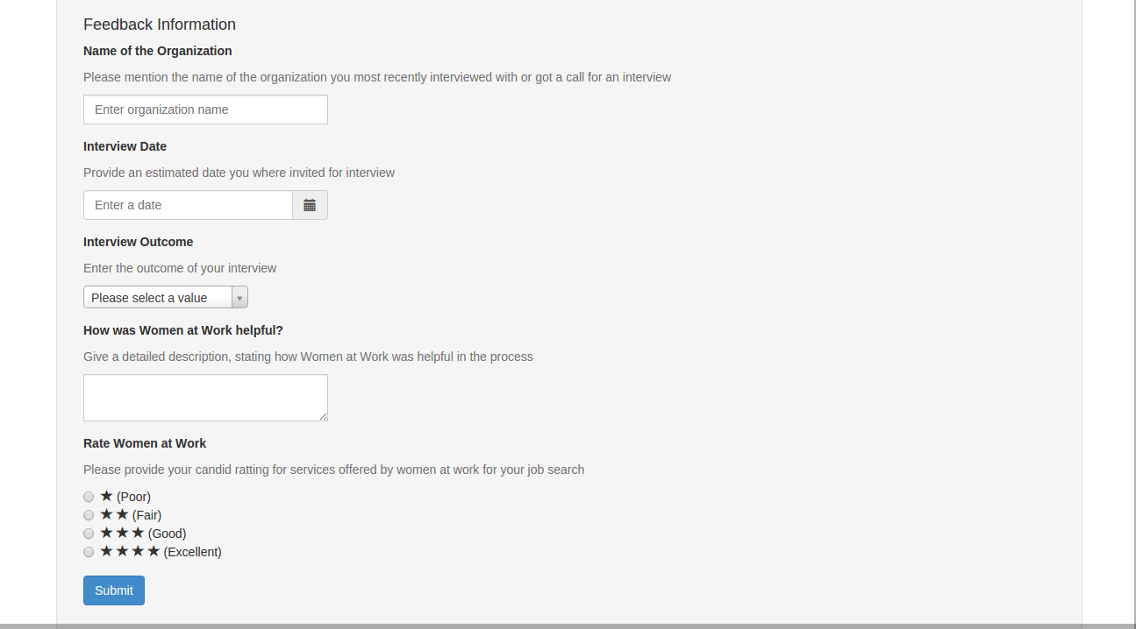
Online Feedback Form - II

Slide 38
Demonstrating Neon CRM REST API
What Win Condition (WC_3199): The system will use Neon CRM as its data store.
Why The API to communicate to Neon CRM is in Beta Stage.
Crucial features of the system (registration and feedback module) heavy depend on the API
How Demonstrating the use of Neon CRM REST API to solve the issue relating to core capability of the system

Slide 39
Demonstrating Neon CRM REST API
What Win Condition (WC_3199): The system will use Neon CRM as its data store.
Why The API to communicate to Neon CRM is in Beta Stage.
Crucial features of the system (registration and feedback module) heavy
depend on the API
How Demonstrating the use of Neon CRM REST API to solve the issue relating
to core capability of the system

Slide 40
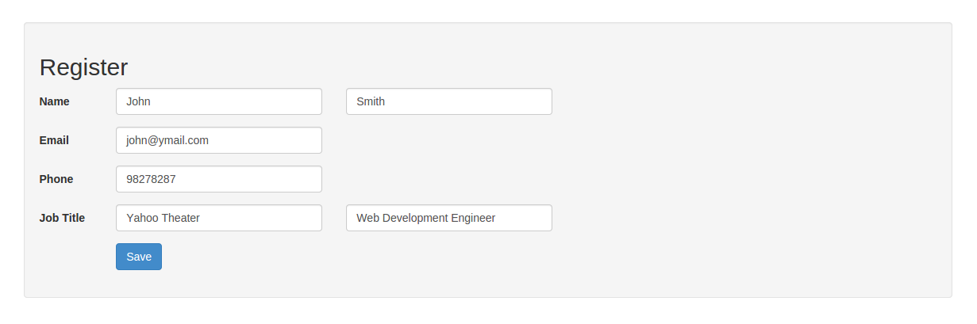
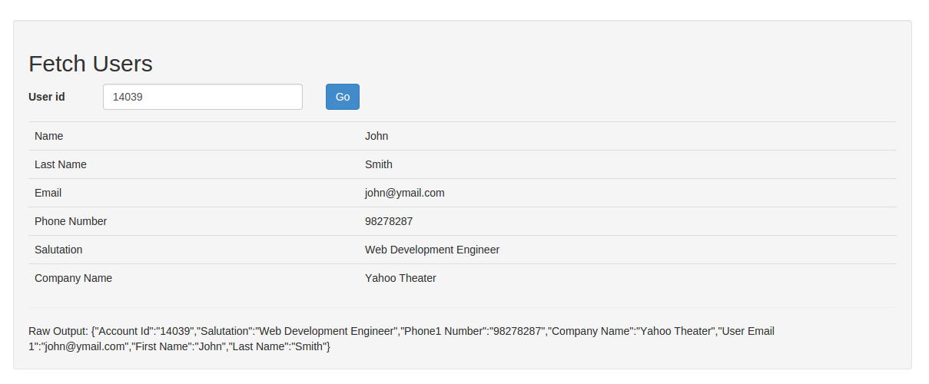
Demonstrating Neon CRM REST API

Slide 41
Maryala Phaneendra
LIFE CYCLE PLAN

Slide 42
Overall Strategy
NDI-Intensive, because of existing non-development items which can be used to deliver the core capabilities of the system
Phases: Exploration and Valuation Phase; Moving into the Foundations and Development Phase
Focus on Quality and Testing
29

Slide 43
Life Cycle Plan Key Stakeholder Responsibilities
Name: Women At Work
Role: Client
Exploration | Provide the details of the project and artifacts related to it.
Valuation | Review the prototype prepared
Foundations | Review the product
Name: Srikanth Madhava
Primary role: Project Manager Secondary role: Operational Concept Engineer
Exploration | Assign tasks to other team members, make progress report and project plan.
Valuation | Review - project progress and prototype, plan and manage the project.
Foundations | Record Project progress and track efforts of individual team members

Slide 44
Life Cycle Plan Key Stakeholder Responsibilities
Name: Maryala Phaneendra
Primary role: Life Cycle Planner Secondary role: System Architect
Exploration | Make a life cycle plan, identify the responsibilities and skills, identify milestones, prepare project plan, and make development strategy.
Valuation | Identify the milestones and the features to be implemented, estimate the cost and effort using COCOMO-II model.
Foundations | Identify tools and methods to be used, Update life cycle plan
Name: Dinesh Reddy Yeduguru
Primary role: Software Architect Secondary role: Prototyper
Exploration | Analyze the proposed system; analyze the interoperability of NDI components.
Valuation | Assess and evaluate the NDI components, assess the system architecture, Make UML diagrams.
Foundations | Design the system architecture; provide feasibility evidence for architecture agile.

Slide 45
Life Cycle Plan Key Stakeholder Responsibilities
Name: Nishant Jani
Primary Role: Prototyper Secondary Role: System Requirements Engineer
Exploration | Exploring existing infrastructure, Analyze the primary requirements.
Valuation | Initial prototype architecture and design, finalized requirement engineering artifacts.
Foundations | Developing prototype.
Name: Rohit Kudva
Primary Role: Feasibility Analyst Secondary role: Project Manager
Exploration | Assess and plan to mitigate risks, analyze the current system.
Valuation | Alternative solutions to the risks, provide feasibility and establish new operational concept.
Foundations | Assess and plan to mitigate risks, operational concept description.

Slide 46
Life Cycle Plan Key Stakeholder Responsibilities
Name: Sanath Bhandary
Primary Role: Operational Concept Engineer Secondary Role: System Requirements Engineer
Exploration | Verify and validate work products, assess the quality management strategy.
Valuation | Verify and validate work products, identify the quality management strategy, identify configuration management.
Foundations | Verify and validate work products, identify the quality management strategy.
Name: Praneet Surana
Primary Role: System Requirements Engineer Secondary Role: Life Cycle Planner
Exploration | Verify and validate work products, assess the quality management strategy.
Valuation | Verify and validate work products, identify configuration management and Plan Lifecycle Assess Quality
Foundations | Identify the quality management strategy,

Slide 47
Life Cycle Plan Key Stakeholder Responsibilities
Name: Brian Bousman
Primary Role: IIV&V Secondary Role: Quality Focal Point
Exploration | Verify and validate work products, assess the quality management strategy.
Valuation | Identify the quality management strategy, identify configuration management, verify and validate work products,
Foundations | Verify and validate work products, identify the quality management strategy.

Slide 48
Life Cycle Plan Resource Estimation
COCOMO II Scale Drivers
Scale Driver | Value | Rationale
PREC | LOW | This is not very similar to the projects that our team had developed before.
FLEX | HIGH | The client briefly defines how the system would be; however, they are open to discussions with the development team.
RESL | HIGH | The thoroughness of the architecture and its freedom from risk is quite high because of the reliability of the existing COTS products and measures taken to avoid the future risks.
TEAM | HIGH | All stakeholders are very collaborative and have strong commitments to achieve the goals of the project.
PMAT | LOW | The team follows just the basic practices of the incremental model.

Slide 49
Life Cycle Plan Resource Estimation (Con’t)
COCOMO II Cost Drivers
PCON | VERY HIGH | We have 8 team members in CSCI577A that is suitable for our project sizing.
APEX | NOMINAL | The average experience of the team members for this online web-based application is about one year.
LTEX | NOMINAL | Some of the tools are new to our team, but it should not be too hard to pick up
PLEX | NOMINAL | The server platform is Wamp and Wordpress, and database is MySQL. The platform is somewhat new to our team, but it is not too hard to pick up
TOOL | HIGH | Use of strong, mature, moderately integrated tools
SITE | EXTRA HIGH | In CSCI577a, five of 7 team members are on-campus students. Additionally, we use wideband electronic communication and occasional video conference.
SCED | NOMINAL | The schedule is fixed for 12 weeks in Fall semester.

Slide 50
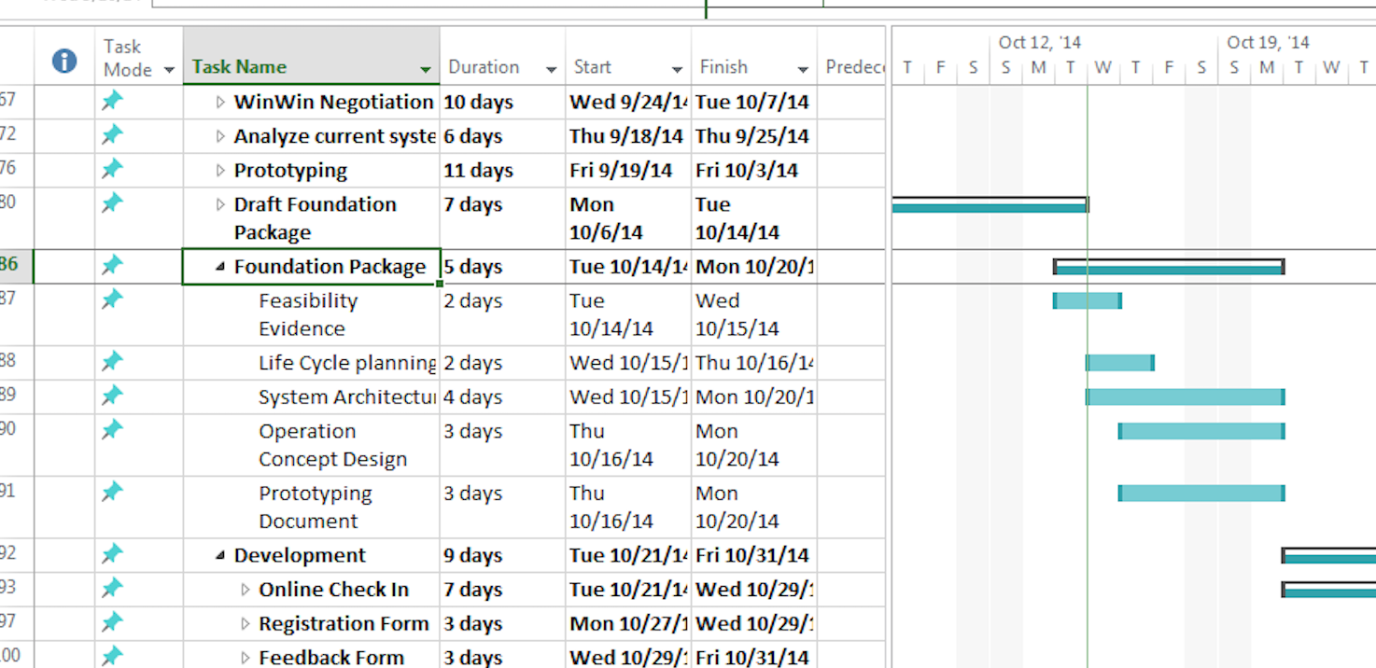
Project Plan(MPP)

Slide 51
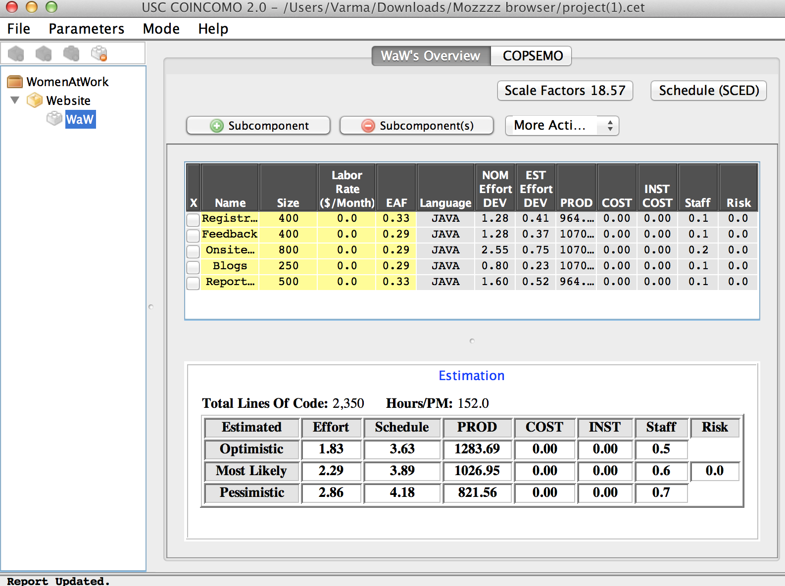
Life Cycle Plan Resource Estimation

Slide 52

Feasibility Analysis
ROHIT KUDVA
10/15/2014
ARCHITECTURE REVIEW BOARD

Slide 53

Rationales For NDI/NCS Model
Criteria | Importance | Project Status | Rationales
30 % of NDI/NCS features | High | High | The project is highly dependent on the use of NDI/NCS and most of the tools utilized in this project are NDI/NCS
Single NDI/NCS | Low | Low | The development team requires the use of atleast 2-3 NDI to deliver the project
10/15/2014
ARCHITECTURE REVIEW BOARD

Slide 54
Rationales For NDI/NCS Model
Internet connection independence | Very Low | Low | The website is currently running on the internet
Need high level of services / performance | Low | Low | The website does not have any high performance requirements
Need high security | Medium | Low | The website is fairly secured by using Neon CRM
10/15/2014
ARCHITECTURE REVIEW BOARD

Slide 55
Rationales For NDI/NCS Model
Rapid deployment | High | Medium | Clients have a website up and running but they require an urgent upgrade to the website
Critical on compatibility | High | High | The new system should be compatible with original system.
Lack of personnel capability | High | Medium | The team has decent knowledge of a couple of NDI's and can easily learn WordPress and Neon CRM
Require little upfront costs | Very High | High | Our clients being a non-profir organization, cost is a critical issue and currently the new system has no upfront costs
10/15/2014
ARCHITECTURE REVIEW BOARD

Slide 56

NDI/NCS ALTERNATIVES
Purpose\Alternatives | Component 1 | Component 2
Customer Relationship Management (CRM) System | Neon CRM
Database Management System | MySQL | MS Access (Jet Engine)
Web Hosting Platform | GoDaddy
Content Management System | WordPress
File Management System | Google Drive | DropBox
Social Media Plugin | ShareThis
10/15/2014
ARCHITECTURE REVIEW BOARD

Slide 57
Evaluation Criteria
No. | Evaluation Criteria – NDI/NCS attributes | Weight
1 | Inter-Component Compatibility | 6
2 | Product Performance | 9
3 | Functionality | 7
4 | Documentation understandibility | 5
5 | Flexibility | 6
6 | Maturity of Product | 4
7 | Vendor Support | 5
8 | Security | 4
9 | Ease of Use | 10
10 | Training Tutorial and Video | 8
11 | Ease of Installation/Upgrade | 6
12 | Ease of maintain | 6
13 | Vendor viability/stability | 4
14 | Compatibility with GoDaddy | 11
15 | Ease of Integration with third-party software | 9
 | Total | 100
10/15/2014
ARCHITECTURE REVIEW BOARD

Slide 58
Evaluation Criteria
No. | NDI/NCS Features/ sub features | Weight
1 | Users can register for the client from website | 26
2 | User can provide online feedback about their current situation to the clients at will and privately | 15
3 | Users can purchase tickets on the website | 4
4 | Users can checkin onsite for the services they want to utilize at the WAW center | 18
5 | IT personnel can generate reports | 10
6 | WAW board members can upload and share files on a common platform | 12
7 | Users can like facebook page from clients website | 7
8 | WAW staff can publish blogs | 8
 | Total | 100
10/15/2014
ARCHITECTURE REVIEW BOARD

Slide 59
Evaluation Results
No | W | MySQL |  |  |  | AVG | Total | MS Access |  |  |  | AVG | Total
 |  | R1 | R2 | R3 | R4 |  |  | R1 | R2 | R3 | R4
1 | 6 | 10 | 9 | 9 | 10 | 9.5 | 57 | 8 | 8 | 7 | 8 | 7.75 | 46.5
2 | 9 | 9 | 9 | 8 | 9 | 8.75 | 78.8 | 9 | 8 | 6 | 8 | 7.75 | 69.75
3 | 7 | 9 | 10 | 8 | 9 | 9 | 63 | 8 | 8 | 8 | 9 | 8.25 | 57.75
4 | 5 | 10 | 9 | 10 | 9 | 9.5 | 47.5 | 8 | 8 | 7 | 7 | 7.5 | 37.5
5 | 6 | 8 | 7 | 9 | 10 | 8.5 | 51 | 7 | 7 | 8 | 8 | 7.5 | 45
6 | 4 | 9 | 6 | 10 | 8 | 8.25 | 33 | 9 | 9 | 8 | 8 | 8.5 | 34
7 | 5 | 8 | 9 | 9 | 9 | 8.75 | 43.8 | 6 | 5 | 7 | 8 | 6.5 | 32.5
8 | 4 | 9 | 9 | 9 | 9 | 9 | 36 | 7 | 6 | 5 | 7 | 6.25 | 25
9 | 10 | 10 | 10 | 10 | 10 | 10 | 40 | 10 | 9 | 8 | 7 | 8.5 | 85
10 | 8 | 9 | 8 | 9 | 10 | 9 | 72 | 8 | 7 | 8 | 7 | 7.5 | 60
11 | 6 | 9 | 10 | 10 | 10 | 9.75 | 58.5 | 7 | 9 | 8 | 7 | 7.75 | 46.5
12 | 6 | 9 | 9 | 8 | 8 | 8.5 | 51 | 7 | 8 | 9 | 10 | 8.5 | 51
13 | 4 | 10 | 7 | 9 | 9 | 8.75 | 35 | 8 | 6 | 8 | 9 | 7.75 | 31
14 | 11 | 9 | 10 | 8 | 9 | 9 | 99 | 7 | 6 | 5 | 7 | 6.25 | 68.75
15 | 9 | 10 | 10 | 9 | 10 | 9.75 | 87.8 | 8 | 7 | 8 | 9 | 8 | 72
Total | 100 |  |  |  |  |  | 853.4 |  |  |  |  |  | 762.4
10/15/2014
ARCHITECTURE REVIEW BOARD

Slide 60
Evaluation Results
No | W | Google Drive |  |  |  |  | Total | DropBox |  |  |  | AVG | Total
 |  | R1 | R2 | R3 | R4 |  |  | R1 | R2 | R3 | R4
1 | 6 | 9 | 10 | 10 | 9 | 9.5 | 57 | 9 | 9 | 10 | 9 | 9.25 | 55.5
2 | 9 | 10 | 10 | 10 | 10 | 10 | 90 | 9 | 9 | 9 | 9 | 9 | 81
3 | 7 | 10 | 10 | 10 | 10 | 10 | 70 | 10 | 9 | 9 | 9 | 9.25 | 64.8
4 | 5 | 9 | 9 | 9 | 10 | 9.25 | 46.3 | 9 | 10 | 9 | 9 | 9.25 | 46.3
5 | 6 | 10 | 10 | 9 | 10 | 9.75 | 58.5 | 9 | 9 | 9 | 10 | 9.25 | 55.5
6 | 4 | 10 | 9 | 9 | 10 | 9.5 | 38 | 9 | 10 | 9 | 9 | 9.25 | 37
7 | 5 | 10 | 10 | 10 | 10 | 10 | 50 | 10 | 9 | 10 | 9 | 9.5 | 47.5
8 | 4 | 10 | 10 | 10 | 10 | 10 | 40 | 9 | 10 | 10 | 10 | 9.75 | 39
9 | 10 | 9 | 10 | 9 | 10 | 9.5 | 95 | 9 | 9 | 10 | 10 | 9.5 | 95
10 | 8 | 9 | 9 | 9 | 9 | 9 | 72 | 10 | 9 | 9 | 10 | 9.5 | 76
11 | 6 | 10 | 10 | 10 | 10 | 10 | 60 | 9 | 10 | 9 | 10 | 9.5 | 57
12 | 6 | 10 | 10 | 9 | 9 | 95 | 57 | 9 | 9 | 9 | 9 | 9 | 54
13 | 4 | 10 | 10 | 10 | 10 | 10 | 40 | 10 | 9 | 10 | 9 | 9.5 | 38
14 | 11 | 10 | 9 | 10 | 10 | 9.75 | 107.3 | 9 | 10 | 9 | 9 | 9.25 | 101.8
15 | 9 | 10 | 10 | 9 | 10 | 9.75 | 87.8 | 10 | 10 | 9 | 9 | 9.5 | 85.5
Total | 100 |  |  |  |  |  | 968.9 |  |  |  |  |  | 933.9
10/15/2014
ARCHITECTURE REVIEW BOARD

Slide 61
NDI Comparison and Evaluation
Metric | MySQL | MS Access (Jet)
Platform | All platforms | Windows Only
Performance | Better compared to MS Access | Worse compare to MySQL
Cost | Open source and no cost | Paid license
Security | SSL support | Username-password
Scalability | >255 | <=255
10/15/2014
ARCHITECTURE REVIEW BOARD

Slide 62
NDI Comparison and Evaluation
Metrics | Google Drive | DropBox
Storage | 15 GB | 2 GB
Support | Support for Google Doc | Cannot create docs on the fly
Cost | Cheap | Expensive
Platform | Windows, Mac OS, iOS and Android | Supports almost all major platforms
10/15/2014
ARCHITECTURE REVIEW BOARD

Slide 63
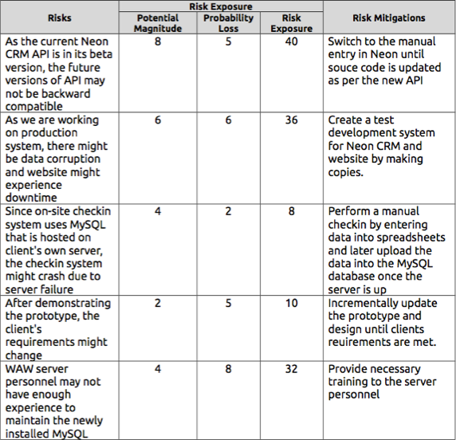

Risk Assessment & Mitigation Strategies
10/15/2014
ARCHITECTURE REVIEW BOARD

Slide 64
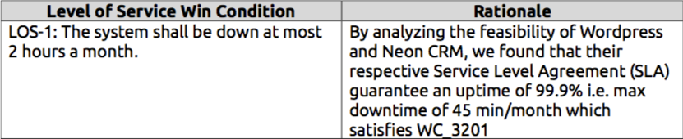

Level of Service (LOS) Feasibility Evidence
10/15/2014
ARCHITECTURE REVIEW BOARD

Slide 65
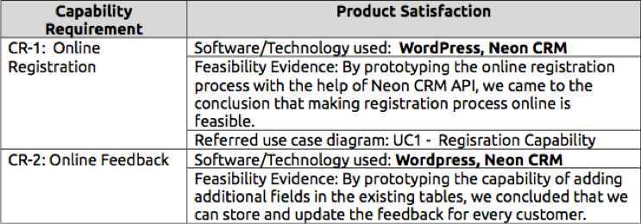

Capability Feasibility Evidence
10/15/2014
ARCHITECTURE REVIEW BOARD

Slide 66
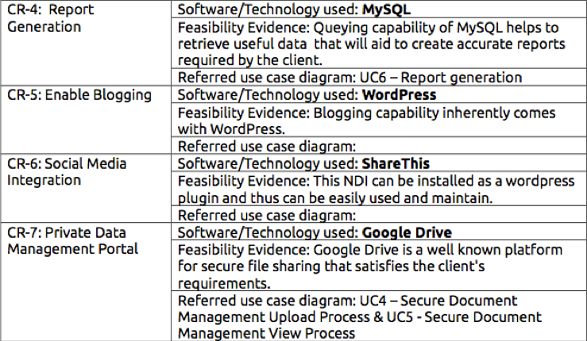
Capability Feasibility Evidence
10/15/2014
ARCHITECTURE REVIEW BOARD

Slide 67
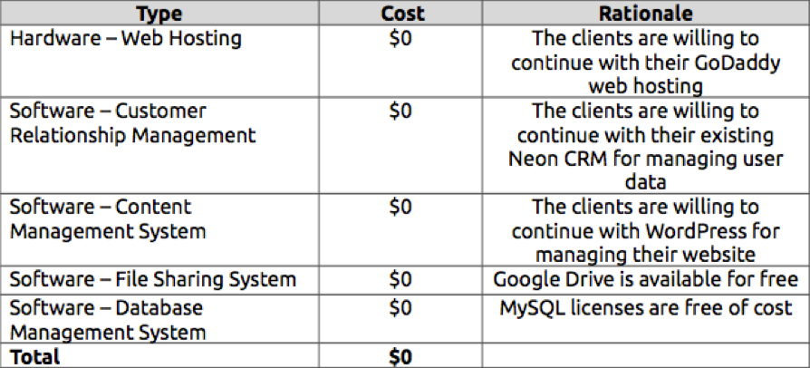
Hardware & Software Costs
10/15/2014
ARCHITECTURE REVIEW BOARD

Slide 68
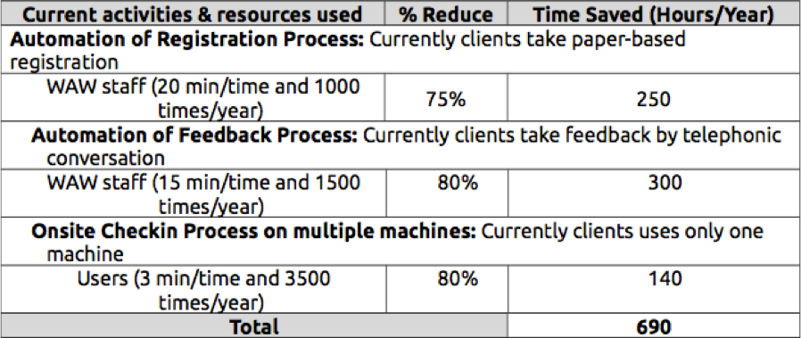

Benefit Analysis
10/15/2014
ARCHITECTURE REVIEW BOARD

Slide 69
Quality Focal Point
Brian Bousman

Slide 70
Traceability Matrix
OCD | WinWin | SSAD Use Case
OC-1 online registration | WC_3189 | UC 2.1.3.1.1
OC-2 onsite check-in | WC_3190 | UC 2.1.3.3.1
OC-3 feedback | WC_3192 | UC 2.1.3.2.1
OC-4 private management portal | WC_3193 | UC 2.1.3.4.1, UC 2.1.3.4.2
OC-5 report generation | WC_3373, 74, 75, 76, 77, 78, 79 | UC 2.1.3.5.1
OC-6 social media integration | WC_3195
OC-7 blogs | WC_3196

Slide 71
Quality Management
Defect Management
Use BugZilla to track bugs and artifact defects
IIV&V reviews all tasks on a weekly basis
IIV&V emails task report to team
Configuration Management
Each team member keeps master copy of document and uploads it to team website
Document has version number in title
Document has embedded revision history
Room For Improvement
Use configuration management tool to better keep track of changes between versions

Slide 72
Defect Identification Review
Review Used
FED – Peer review in group meeting
LCP – Peer review in group meeting
OCD – Peer review in group meeting
PRO – Peer review in group meeting
SSAD – Peer review in group meeting

Slide 73
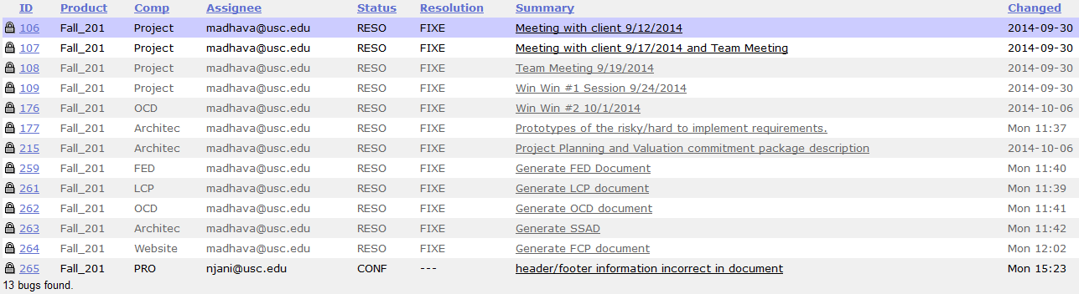
Defect Matrix

